Slide 1




Practical Parenting
Wisdom for Parenting
in a Screen-Saturated World

Slide 2
Wisdom Principle #1
Be the parent
Hear, my son, your father’s instruction,
and forsake not your mother’s teaching
Train up a child in the way he should go;
even when he is old he will not depart from it.
Proverbs 1:8
Proverbs 22:6

Slide 3

Wisdom Principle #2
Talk about Tech
Proverbs 4:1-7
axis.org
Culture Translator, Parent Guides

Slide 4
Wisdom Principle #3
Teach them to control their fingers (their tongue)
Slow to Speak
Speak Honestly
Speak Kindly
Proverbs 15:28
Proverbs 18:13
Proverbs 13:3
Proverbs 12:19
Proverbs 15:1

Slide 5
Wisdom Principle #4
Teach them to spot foolishness
Psalm 14:1
Proverbs 9:13-18

Slide 6
80%
of teens are exposed to pornography
Wisdom Principle #5
Teach them to guard against sexual immorality
62%
of teens have received a nude image on their phone
Proverbs 5:3-6
10%
of visitors to porn sites are younger than 10 years old

Slide 7
Wisdom Principle #6
Teach them to reject laziness
Proverbs 6:6-11
26% of teens believe they will definitely be famous by the time they are 25 years old

Slide 8
Wisdom Principle #7
Teach them to love knowledge, wisdom, and learning
Give instruction to a wise man, and he will be still wiser;
teach a righteous man, and he will increase in learning.
Blessed is the one who finds wisdom,
and the one who gets understanding.
Proverbs 3:13-18
Proverbs 9:9

Slide 9
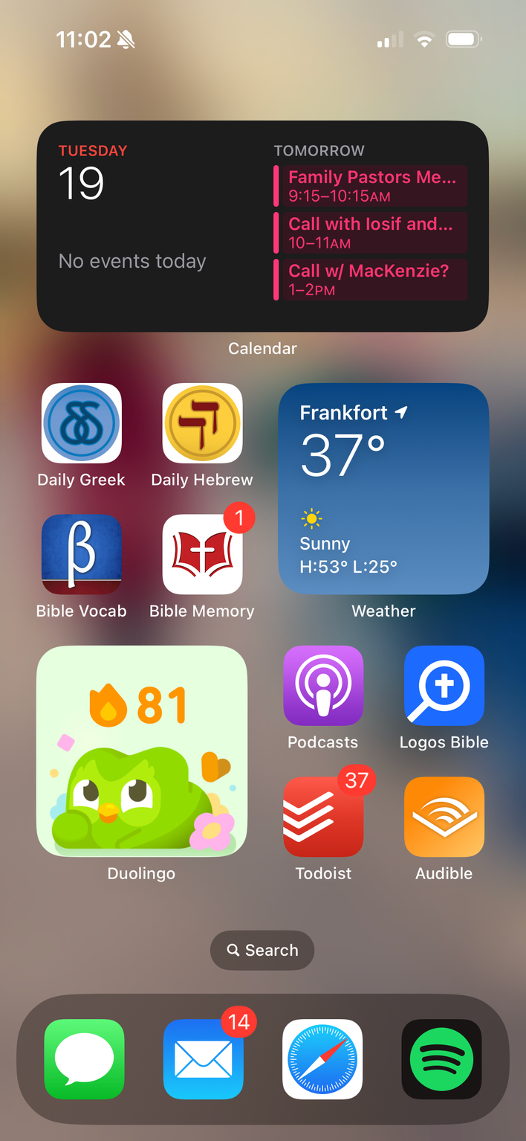

Slide 10




Wisdom Principle #8
Be the example of wisdom with screens

